Slide 1
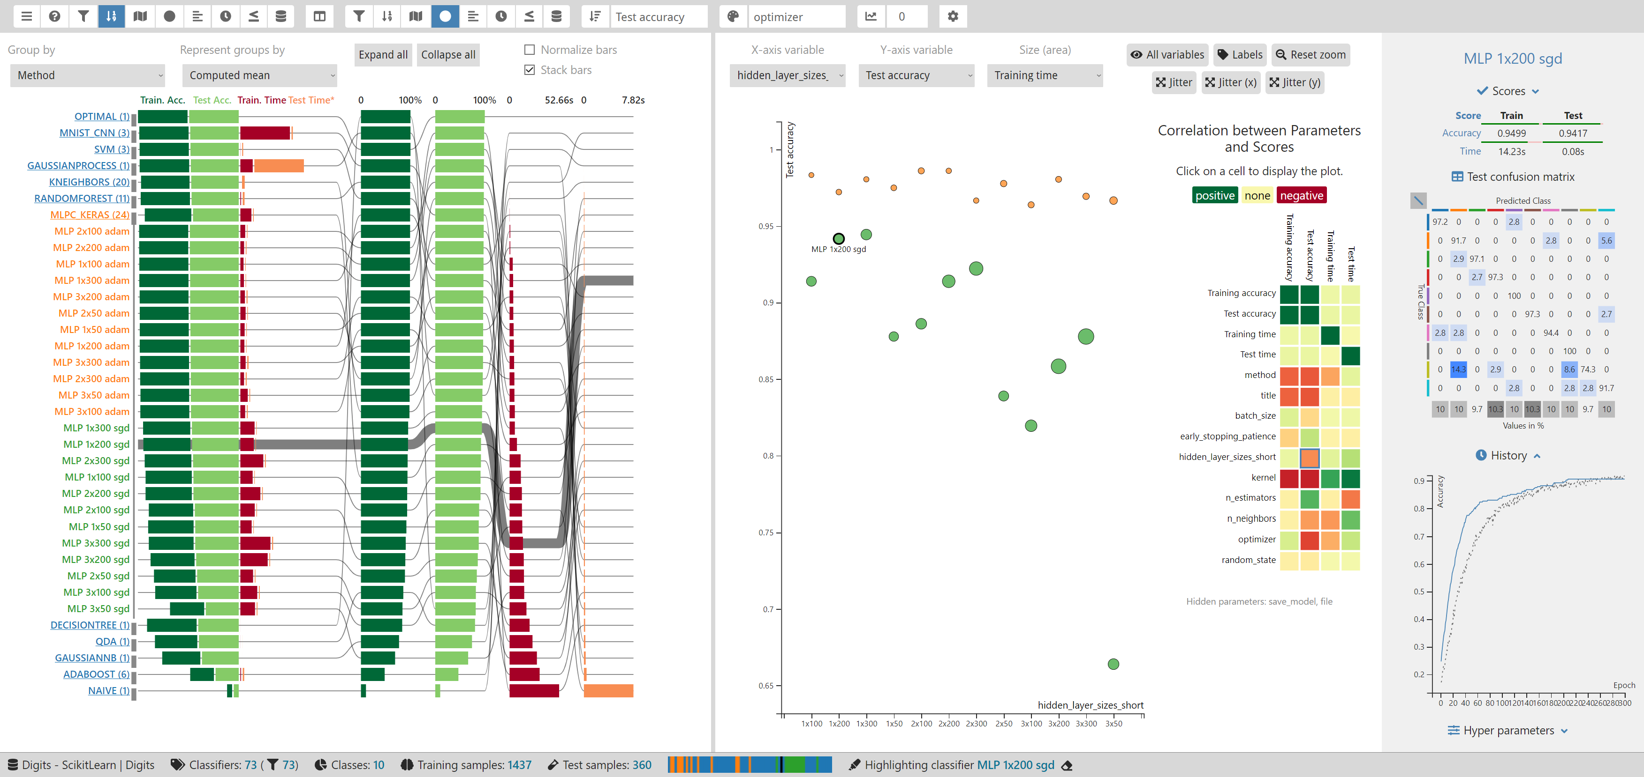
AVI 2020
ClaVis: An Interactive Visual Comparison System for Classifiers
Frank Heyen, Tanja Munz, Michael Neumann, Daniel Ortega, Ngoc Thang Vu, Daniel Weiskopf, Michael Sedlmair
Notes:
ClaVis: An Interactive Visual Comparison System for Classifiers

Slide 2
Classification is Important!
Natural language processing
Computer vision
Medical diagnostics
…
Notes:
Classification is an important task in fields such as
natural language processing,
computer vision,
and medical diagnostics

Slide 3
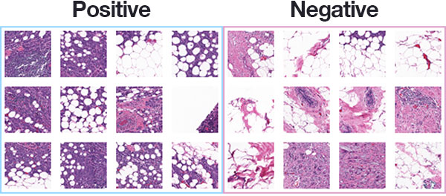
Classification is Important!
Natural language processing
Computer vision
Medical diagnostics
…
Cancer classification can save lifes!
https://www.pyimagesearch.com/2019/02/18/breast-cancer-classification-with-keras-and-deep-learning/
Notes:
For example, we can use classification for cancer detection, where it can help save human lives!

Slide 4
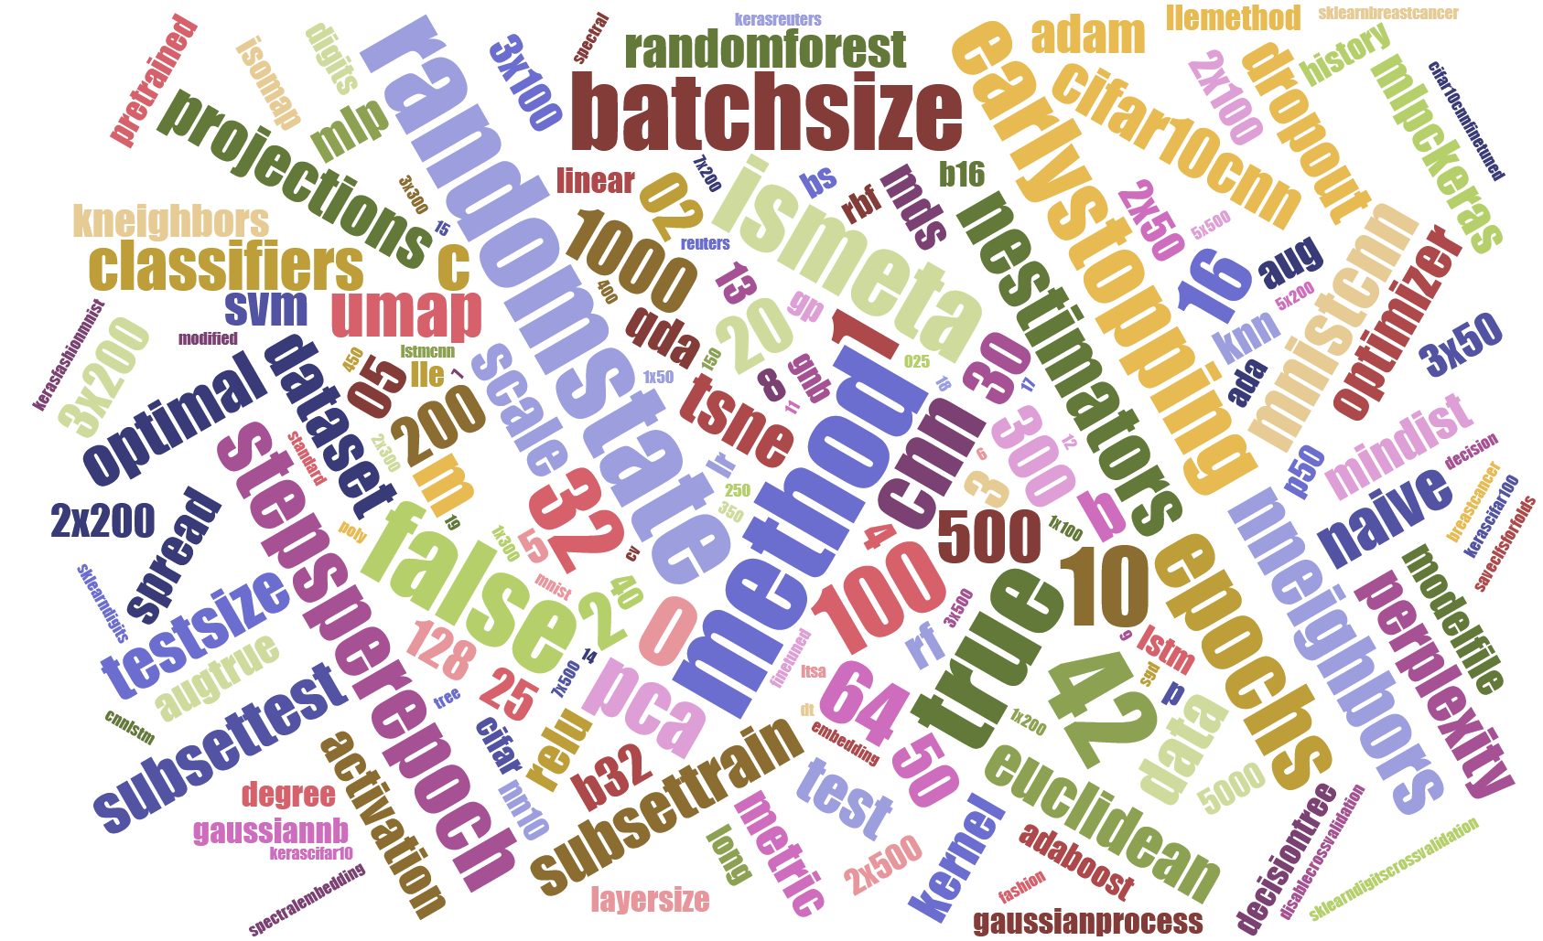
Classification is Hard!
Different types of data and features
Many classification methods
Lots of hyperparameters (HPs)
Notes:
On the other hand, creating a good classifier is hard, since there are
Different types of data and features
For example images, text, or speech, ...
Many classification methods
Such as neural networks, Random Forest classifiers, or support vector machines, ...
And most of those methods have lots of hyperparameters that we need to configure
Like optimizer, learning rate, or network architecture ...

Slide 5
Classification is Hard!
How can classifier developers ...
Create a good classifier for a problem (and what is good)?
Understand the influence of HPs?
Choose appropriate HP values?
Notes:
We need to support developers in creating good classifiers, were the exact meaning of ‘good’ depends on the actual use case.
To be able to do this, developers need to understand,
how hyperparameters influence the training of a classifier,
so they can choose the best values for those parameters

Slide 6
Baseline
State of the art process for many:
Choose HPs
Learn from Results
Train Classifiers
Test Classifiers
Notes:
For many developers, the state of the art process looks like this:
They choose initial hyperparameter values,
train and test classifiers,
and if they don’t work well enough,
the developers try to find better values based on the results.

Slide 7
Baseline
This does not give much insight into the HP space!
Our goal: Allow for an informed HP choice!
Choose HPs
Learn from Results
Train Classifiers
Test Classifiers
Notes:
This is an iterative process and a lot of guesswork.
It would be better to understand what the parameters actually do,
so we could make in informed parameter choice.

Slide 8

Baseline
This does not give much insight into the HP space!
Our goal: Allow for an informed HP choice!
Choose HPs
Learn from Results
Train Classifiers
Try a lot of HP values (at once!)
Understand HPs
Use HPs effectively
Test Classifiers
Notes:
In short, we want to replace this iterative process by one that produces insight faster and more directly.

Slide 9
Idea: Use Visual Parameter Space Analysis*
Sample HP Space,
Train Classifiers
Results
Visual Analysis,
Insight
* Sedlmair et al. (2014) Visual parameter space analysis: A conceptual framework. IEEE TVCG, 20 (12), 2161-2170. doi.org/10.1109/TVCG.2014.2346321
Notes:
Our approach for this task is based on visual parameter space analysis.
and works in two steps:
First, we sample some hyperparameter values from the parameter space and train classifiers with them
then, we use visual analytics to detect patterns.
This will give us insight into the parameter space
and thereby allow us to choose hyperparameter values more wisely.

Slide 10
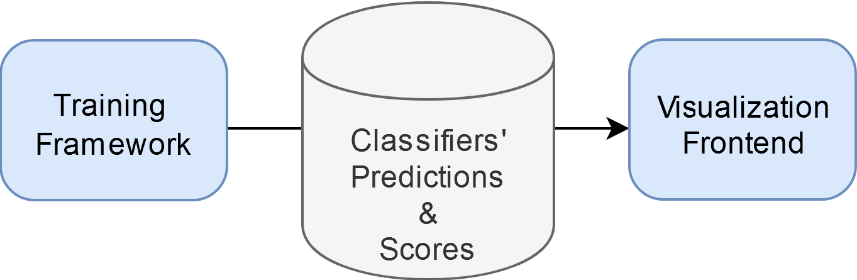
Idea: Use Visual Parameter Space Analysis*
Sample HP Space,
Train Classifiers
Results
Visual Analysis,
Insight
* Sedlmair et al. (2014) Visual parameter space analysis: A conceptual framework. IEEE TVCG, 20 (12), 2161-2170. doi.org/10.1109/TVCG.2014.2346321
Notes:
ClaVis consists of two main parts that reflect the two steps:
A training framework that simplifies the parameter sampling and training,
and a visualization frontend that allows to analyze the resulting classifiers.

Slide 11
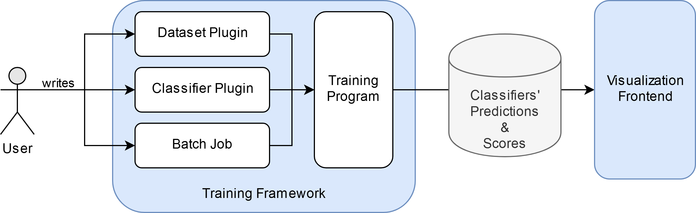
ClaVis’ Workflow
Move (existing) code into plugins
Notes:
Most machine learning developers use Python and libraries such as Pandas, Scikit-Learn, or TensorFlow for their work.
ClaVis allows users to create Python plugins with a simple API,
so they can reuse existing code and use any Python library they want or need.

Slide 12
ClaVis’ Workflow
Move (existing) code into plugins
Specifiy all HP values to sample
Notes:
After creating these plugins, users then define batch jobs.
Batch jobs are simply JSON files that specify what hyperparameter values should be sampled.
This makes the sampling step easier to configure and reproduce.
For ClaVis, hyperparameters include everything that you can configure for a classifier, including
Classifier method,
Architecture,
Data preprocessing options,
Or even a file to load a saved model from, for example for fine-tuning.
The classifiers will be named after their parameter values.
This allows to easily identify them later.
The source code in our supplementary material contains examples for plugins and batch jobs that demonstrate all mentioned use cases.

Slide 13
Workflow
Results can be analyzed all at once
Or shared for reproducibility (useful for academics & teaching!)
Notes:
The training results are stored in files, so they can be archived or shared for reproducibility.
This also allows to analyze them again at any time,
for example to compare them to new classifier implementations.
The analysis can be done on a different computer then the one that was used for training,
and the training even can done on multiple machines or in multiple sessions.
If something breaks, the training can simply be continued later, after fixing the issue.
If researchers or students would share their trained models, or even the results produced by our training program,
ClaVis could be used to compare own results to those of other people.
This would be similar to machine learning competitions, but would show more than just a simple ranking by a single criterium.

Slide 14
How does ClaVis support analysis?
Notes:
So now that we covered the sampling and training step, let’s see how ClaVis supports the visual analysis.

Slide 15
ClaVis’ Visualization Frontend
Two visualizations with brushing & linking
Notes:
ClaVis can show one or two main views at once.
When it shows two, they are linked such that interaction with one is reflected in the other as well.

Slide 16
ClaVis’ Visualization Frontend
Details for highlighted
classifier
Two visualizations with brushing & linking
Notes:
When the user highlights a classifier, its details are shown in a panel on the right.
These classifier details include a
summary of scores,
a confusion matrix,
a training history chart,
and a list of all hyperparameter values.

Slide 17
ClaVis’ Visualization Frontend
Sort, colorize, or filter by HPs and scores
Details for highlighted
classifier
Two visualizations with brushing & linking
Notes:
A toolbar allows to sort and colorize classifiers based on hyperparameters and scores.
Filtering by those attributes is also possible.

Slide 18
Now let’s see how ClaVis supports tasks!
Notes:
Now let’s see how we support various classifier design tasks, which is the main part of this talk.

Slide 19
Finding Well-Performing Classifiers
What is best?
High accuracy, fast training, …?
Trade-off!
Notes:
Once we have sampled some parameters and trained the classifiers, the first thing we usually want is to see what parameter choices worked best.
But what do we mean by best?
There are many ways to measure the quality of a classifier’s predictions, for example accuracy.
But a classifier with high accuracy might take too long for training, especially if the use case requires to re-train it often.
The time needed for prediction might be also be important, for example for real time computer vision.
This means, that we usually need to make a trade-off between different scores!
In this talk we limit ourselves to accuracy for simplicity, but most visualizations would work with any other numerical score,
such as precision and recall, or area under curve.

Slide 20
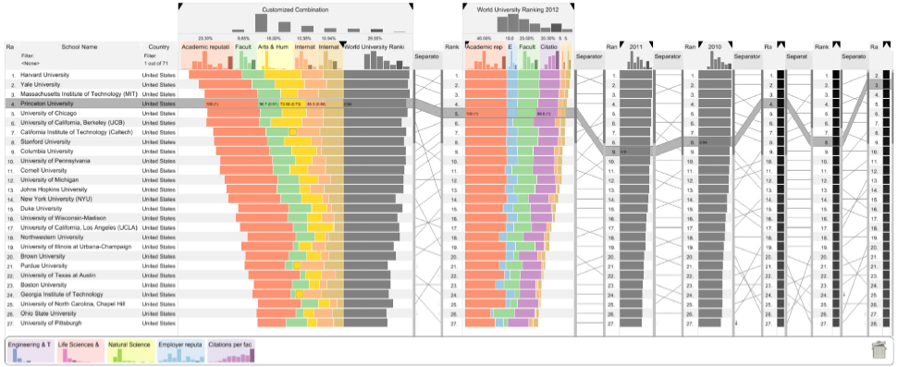
Finding Well-Performing Classifiers
We need a ranking for multiple scores at once
LineUp* does this well, so we build on top of it:
* Gratzl et al. (2013) LineUp: Visual analysis of multi-attribute rankings. IEEE TVCG, 19, (12), 2277-2286. doi.org/10.1109/TVCG.2013.173
Notes:
To make trade-off decisions, we can use a ranking by multiple scores.
The one we created is based on the lineup visualization that was published by Gratzl and others.
Since our ranking visualization is a bit complex, I will now go trough its features step by step.

Slide 21
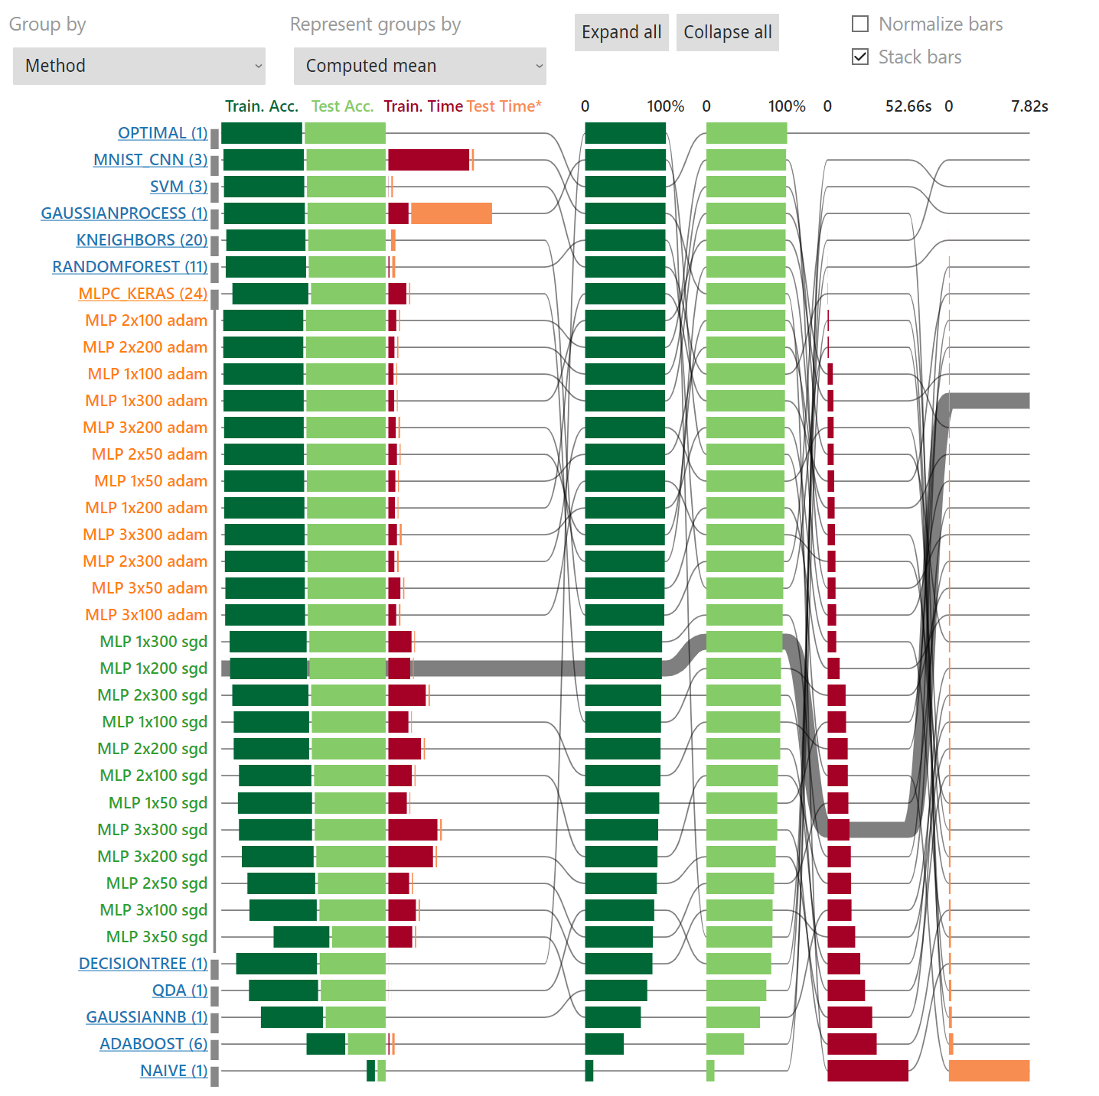
Finding Well-Performing Classifiers
Green bars: training/test accuracy
Notes:
As you can see here, we use dark and bright green bars for training and test accuracy.

Slide 22
Finding Well-Performing Classifiers
Green bars: training/test accuracy
Red/orange bars: training/test time
Notes:
And red and orange bars for the training and test time.
The red and orange colors and the positioning to the right of a central baseline indicate that this is a negative score,
which means that larger bars indicate worse classifiers.
Good classifiers will have big green bars and small red and orange ones.

Slide 23
Finding Well-Performing Classifiers
Green bars: training/test accuracy
Red/orange bars: training/test time
One combined ranking, four separate ones
Notes:
We show one combined ranking on left
and single rankings for each score on the right.
Single rankings are sorted, such that the best value is at the top,
This means we can find the best classifiers for each score by simply taking a look at the top of these rankings.
The single rankings also reveal the distribution of score values, similar to a histogram.

Slide 24
Finding Well-Performing Classifiers
Green bars: training/test accuracy
Red/orange bars: training/test time
One combined ranking, four separate ones
Connections and highlighting
Notes:
To make it possible to find the positions of a classifier in all rankings, we draw lines that connect these positions.
Hovering a classifier highlights its line for better visibility

Slide 25
Finding Well-Performing Classifiers
Green bars: training/test accuracy
Red/orange bars: training/test time
One combined ranking, four separate ones
Connections and highlighting
Grouped by method
Notes:
Classifiers can be grouped by any hyperparameter, here for example the classification method.
For these groups, ClaVis then shows a summary entry with either the mean or median scores,
or the scores of the top classifier, based on the current global sorting.

Slide 26
Finding Well-Performing Classifiers
Green bars: training/test accuracy
Red/orange bars: training/test time
One combined ranking, four separate ones
Connections and highlighting
Grouped by method
Some groups collapsed
Notes:
The groups can be collapsed by clicking on their summary.
This reduces clutter and makes a comparison between groups easier.
Here, we are only interested in multi-layer perceptrons and have therefore collapsed all other groups.
Grey bars next to the classifier’s names help to better distinguish the groups.

Slide 27
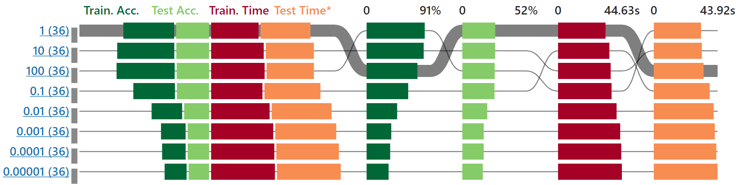
Finding Well-Performing Classifiers
Grouped by one HP, 36 different classifier parametrizations in each group
Notes:
In this example, we have grouped the classifiers by one hyperparameter.

Slide 28
Finding Well-Performing Classifiers
Best (avg.) test accuracy and training time!
Grouped by one HP, 36 different classifier parametrizations in each group
Notes:
We can see that a value of 1 leads to the best test accuracy AND training time on average.
This is easy to see, since the classifier group for ‘1’ is on the top-most position in the single rankings of those scores.
So now we now that 1 would be a good choice for this parameter.

Slide 29
Analyzing The Influence of Hyperparameters on Scores
Scatterplot for the correlation between HPs and scores
Correlation matrix as an overview
Notes:
To understand the effect of hyperparameter choices in more detail,
we can also analyze the correlation between parameters and scores.
For this task, we implemented a scatterplot that shows this correlation,
as well as a correlation matrix, that provides an overview of all pairs of parameters and scores.

Slide 30
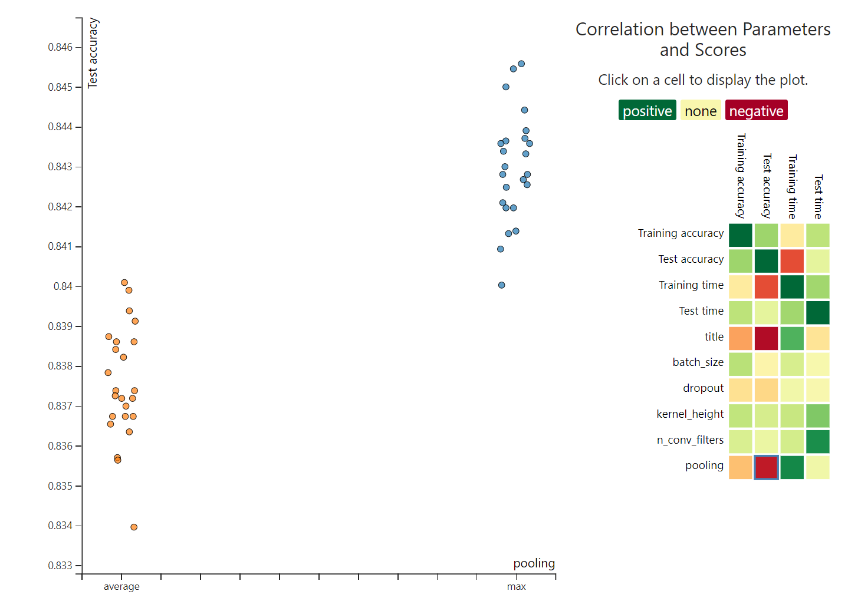
Analyzing The Influence of Hyperparameters on Scores
Example:
Correlation matrix indicates influence of pooling method
Click shows plot
Notes:
The correlation matrix can show us which of these pairs might be interesting to analyze.
In this example, we could click on the matrix cell for pooling versus test accuracy to show the corresponding scatterplot.

Slide 31
Analyzing The Influence of Hyperparameters on Scores
Example:
Correlation matrix indicates influence of pooling method
Scatterplot confirms this
Click shows plot
Notes:
After we do this, we see that there is a strong influence of the pooling method on accuracy.
The orange group of classifiers has a significantly lower accuracy then the blue group.

Slide 32
Analyzing The Influence of Hyperparameters on Scores
Example:
Correlation matrix indicates influence of pooling method
Scatterplot confirms this
Jitter for better visibility
Notes:
Since the pooling method parameter has discrete values, all classifiers would be plotted onto the same horizontal position.
We applied some horizontal jitter to better see the distribution.
We could also zoom in to get an even clearer image.

Slide 33
Analyzing The Influence of Hyperparameters on Scores
Example:
Correlation matrix indicates influence of pooling method
Scatterplot confirms this
Notes:
Apart from general patterns, this view can also show for example outliers that could be further analyzed, to see what separates them from the rest.

Slide 34
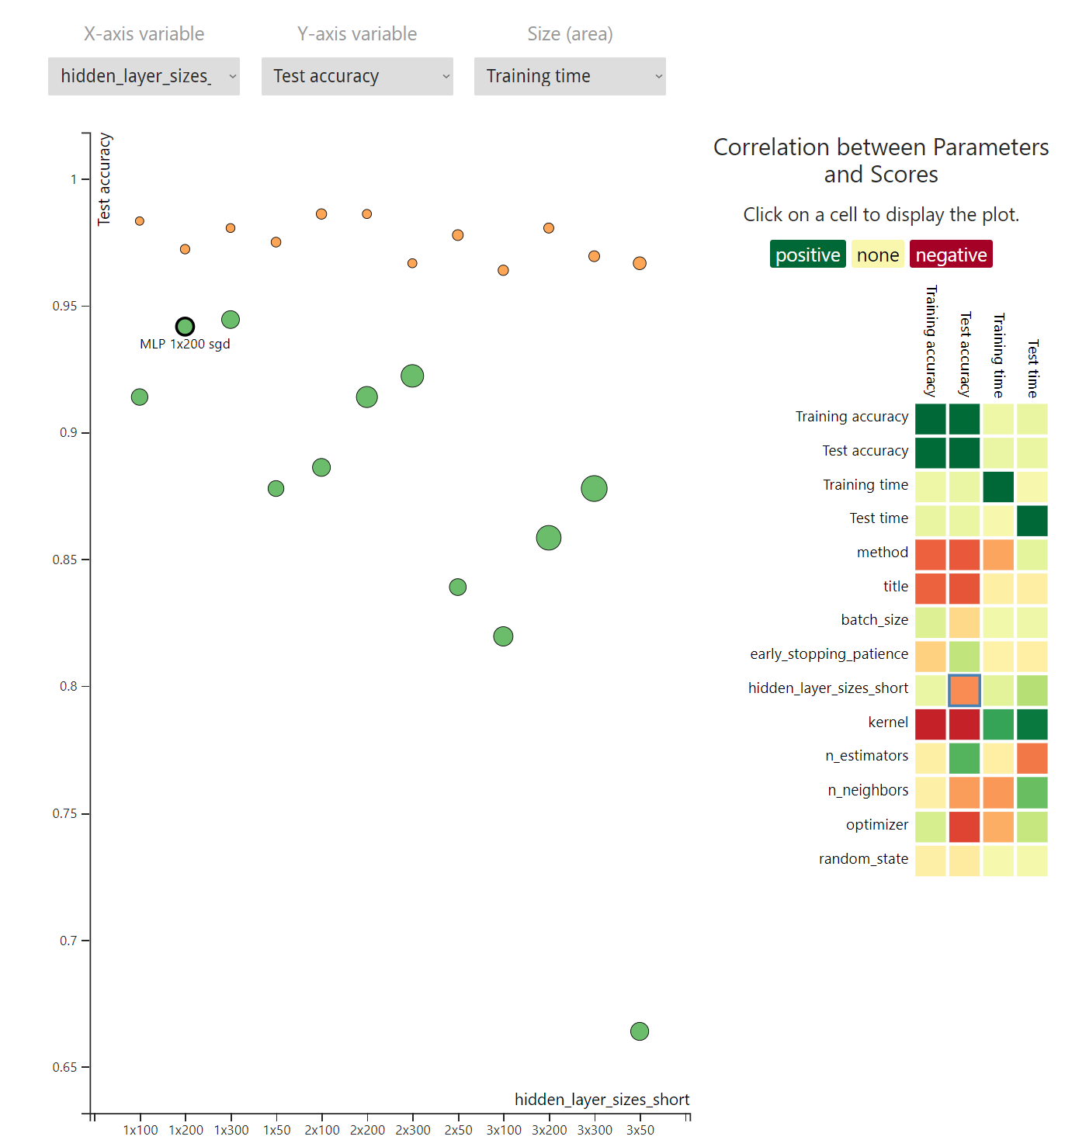
Analyzing The Influence of Hyperparameters on Scores
Another example:
Colored by optimizer
Notes:
In this second example, we first colorized classifiers depending on their optimizer so we can better distinguish the two groups.

Slide 35
Analyzing The Influence of Hyperparameters on Scores
Another example:
Colored by optimizer
Correlation: architecture – accuracy
Orange classifiers are better!
better
Notes:
Since we mapped test accuracy to the y axis, we can see that the orange group performs better, as it is higher up.

Slide 36
Analyzing The Influence of Hyperparameters on Scores
Another example:
Colored by optimizer
Correlation: architecture – accuracy
Orange classifiers are better!
Time mapped to area
Orange classifiers are trained faster!
better
faster
Notes:
Mapping training time to area shows us, that the orange classifiers are also trained faster, as their areas are smaller!
In this case, we would clearly use the optimizer of the orange classifiers.

Slide 37
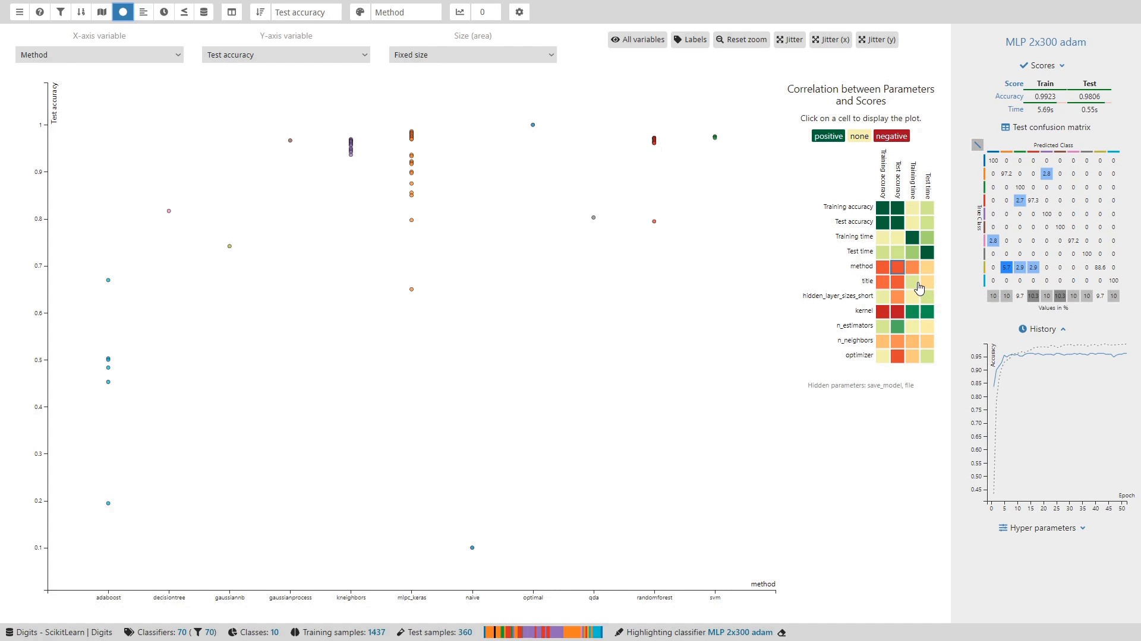
Notes:
This demo video shows how we got to the last example:
First, we click on the correlation matrix to show the corresponding scatterplot,
then, we colorize by optimizer,
next, we map training time to area,
and last, we can also show labels, to identify the classifiers.

Slide 38
Analyzing the Prediction Behavior
Assumptions:
Classifiers are similar ⇔ predictions are similar
Closer to correct predictions ⇔ better (and more confident!) predictions
Notes:
Another interesting task is to compare classifiers based on their predictions.
This allows to see how parameters influence the predicted class labels and probabilities.
It is important, that predictions are not only correct, they also need to have confident probabilities to be reliable.

Slide 39
Analyzing the Prediction Behavior
Similarity map
Predictions / Probabilities
Flatten
Vectors
Notes:
For the analysis of classifiers’ prediction behavior, we implemented a similarity map.
To draw it, we first take the predictions or predicted probabilities of all classifiers and flatten them into vectors.
This gives us one vector for each classifier.

Slide 40
Analyzing the Prediction Behavior
Similarity map
Predictions / Probabilities
Flatten
Vectors
Dimensionality Reduction
2D Image
Notes:
We can then use dimensionality reduction in order to project these vectors down to two dimensions.
A scatterplot can then be drawn to visualize this two-dimensional data.

Slide 41
Analyzing the Prediction Behavior
Similarity map
Closeness ≈ similar predictions
Predictions / Probabilities
Flatten
Vectors
Dimensionality Reduction
2D Image
Notes:
In this scatterplot, closeness should indicate a similar prediction behavior.

Slide 42
Analyzing the Prediction Behavior
Similarity map
Closeness ≈ similar predictions
Baselines:
Optimal: perfect prediction
Naïve: always predicts biggest class
Predictions / Probabilities
Flatten
Vectors
Dimensionality Reduction
2D Image
Notes:
We also added two baselines for reference:
The optimal classifier produces perfect predictions
and the naïve classifier predicts the biggest class of the dataset for all data samples.
The second one is also referred to as a majority class baseline.

Slide 43
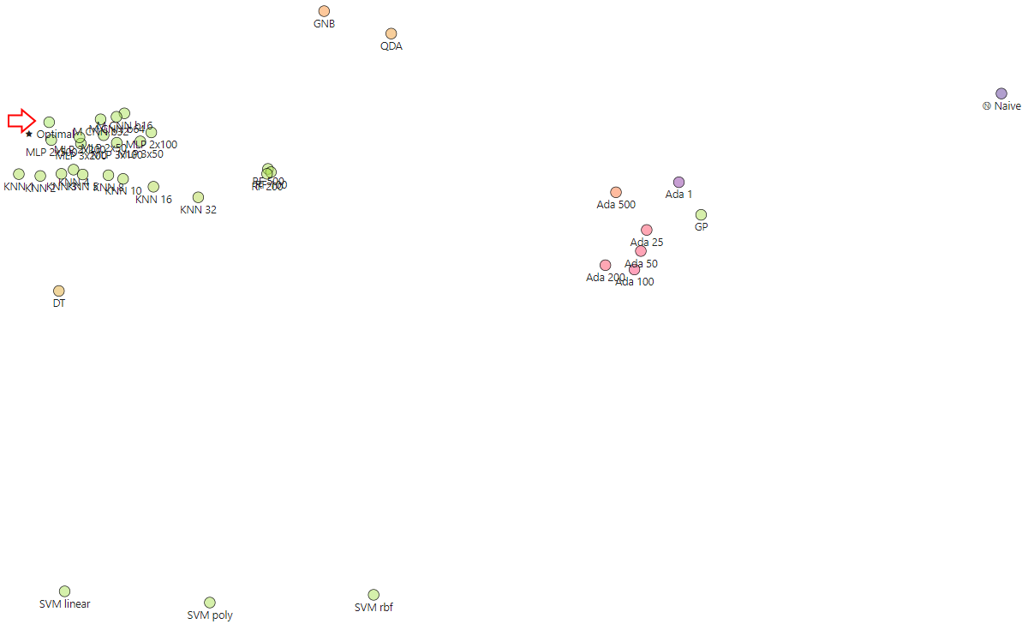
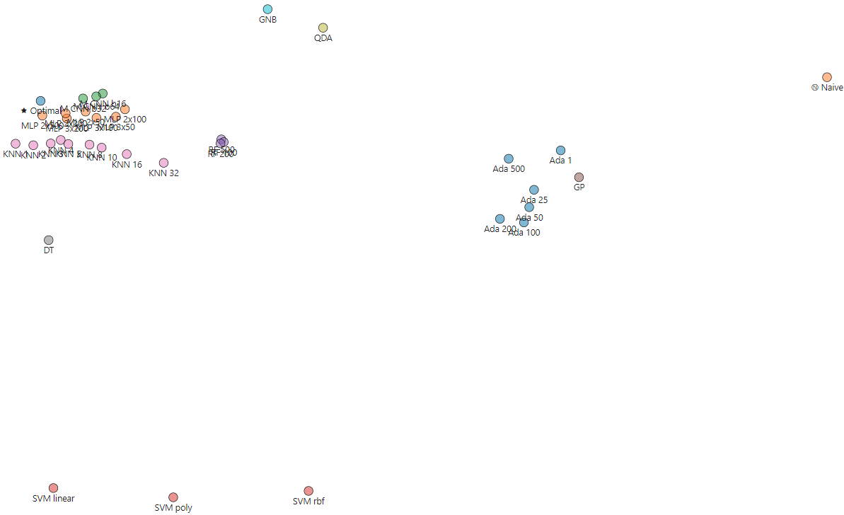
Analyzing the Prediction Behavior
Colored by method: Classifiers of the same method are closer
Notes:
To check whether the similarity map works, we trained some very different types of classifiers, like
tree-based classifiers,
support vector machines,
and k-nearest neighbor classifiers.
We colorize them by their classification method,
and indeed, we can see, what we would expect:
Classifiers of the same method are closer to each other
than to those of a different method.

Slide 44
Analyzing the Prediction Behavior
Colored by accuracy: Good (green) classifiers are close to Optimal
Notes:
Now, we take the same classifiers and colorize them by accuracy.
We can see that good classifiers, here in green, are generally closer to the optimal prediction than bad classifiers.
If classifiers are green, but far away from the optimal predictions, they have high accuracy but might have less confidence.
But this effect can also be an artifact of the dimensionality reduction algorithm, so it is important to try different ones!

Slide 45
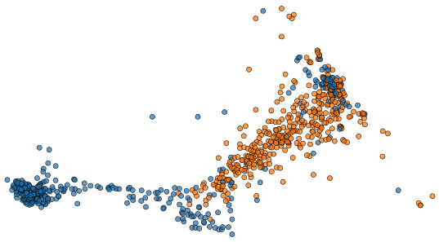
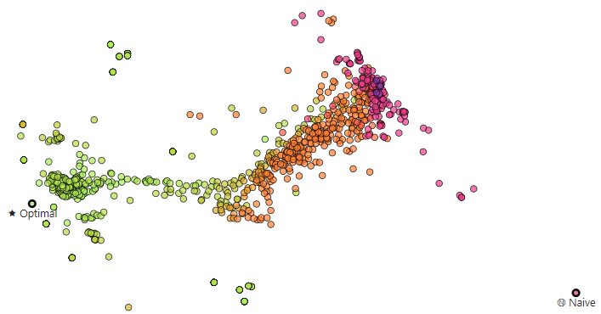
Analyzing the Prediction Behavior
Colored by optimizer: shows clusters
Colored by accuracy: one optimizer is better
Notes:
The similarity map visualization also works when showing lots of classifiers at once.
When we colorize them by optimizer, we can see that the optimizer choice seems to strongly influence predictions.

Slide 46
Analyzing the Prediction Behavior
Colored by optimizer: shows clusters
Colored by accuracy: ‘blue optimizer’ is better
Notes:
After colorizing by accuracy and comparing the two images, we see that the ‘blue optimizer’ generally works better than the other one.

Slide 47
Analyzing the Prediction Behavior
Colored by optimizer: shows clusters
Colored by accuracy: ‘blue optimizer’ is better
Notes:
But not in all cases!
There are blue classifiers that are far away from the optimum
and have a low accuracy, as indicated by their color.

Slide 48
Analyzing the Training Behavior
How fast do classifiers learn?
Other problems during training?
Notes:
The training behavior of classifiers can also be interesting.
We can analyze how fast classifiers learn and whether they have issues such as overfitting by analyzing their training history.

Slide 49
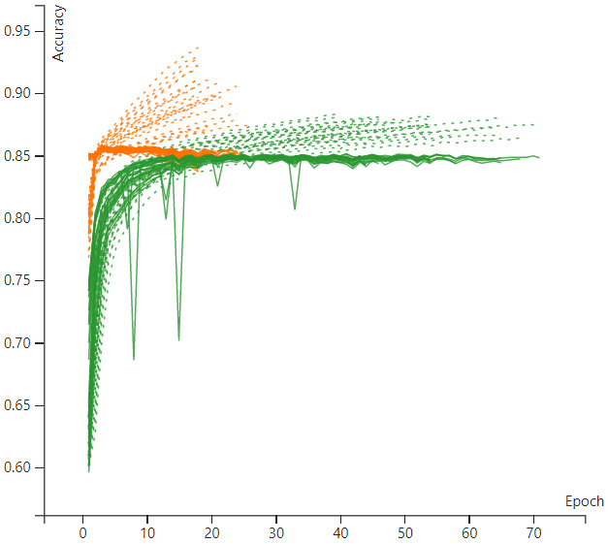
Analyzing the Training Behavior
Dashed: training scores
Solid: test scores
Notes:
We visualize this history as a line chart with
dashed lines for the training scores
and solid lines for the test scores.

Slide 50
Analyzing the Training Behavior
Two groups of classifiers (orange and green)
Notes:
Here, we have two groups of classifiers, colored orange and green.

Slide 51
Analyzing the Training Behavior
Green classifiers
Learn slower
Notes:
We can see that the green classifiers take longer to reach their maximum accuracy.

Slide 52
Analyzing the Training Behavior
Green classifiers
Learn slower
Have weird accuracy drops
Notes:
And that they also have sudden drops in accuracy,
while the orange ones are much more stable.

Slide 53
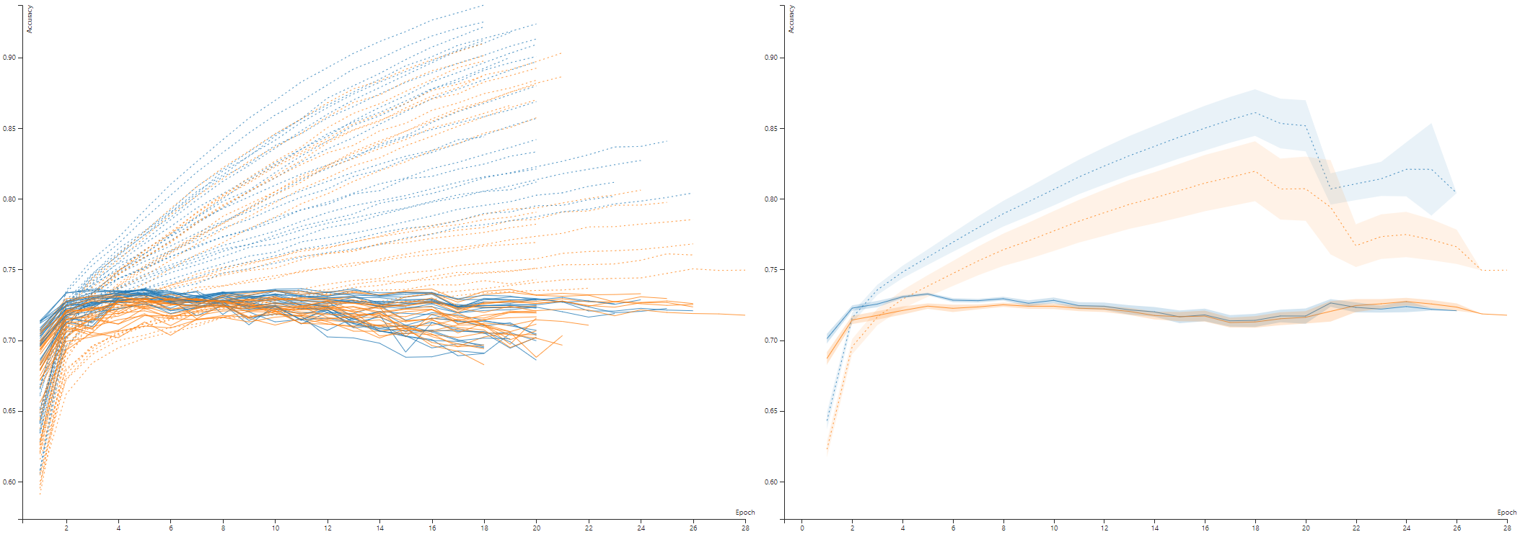
Analyzing the Training Behavior
TODO
Mean & confidence interval,
allows comparing large groups
Cluttered!
Notes:
Showing so many lines at once leads to clutter
and makes it hard to see differences between groups.

Slide 54
Analyzing the Training Behavior
TODO
Mean & confidence interval,
allows comparing large groups
Cluttered!
Notes:
Therefore, this visualization allows the user to switch to only showing the mean and confidence interval for each group.
They are shown for both training and test scores, but the training scores can also be hidden for even less clutter.

Slide 55
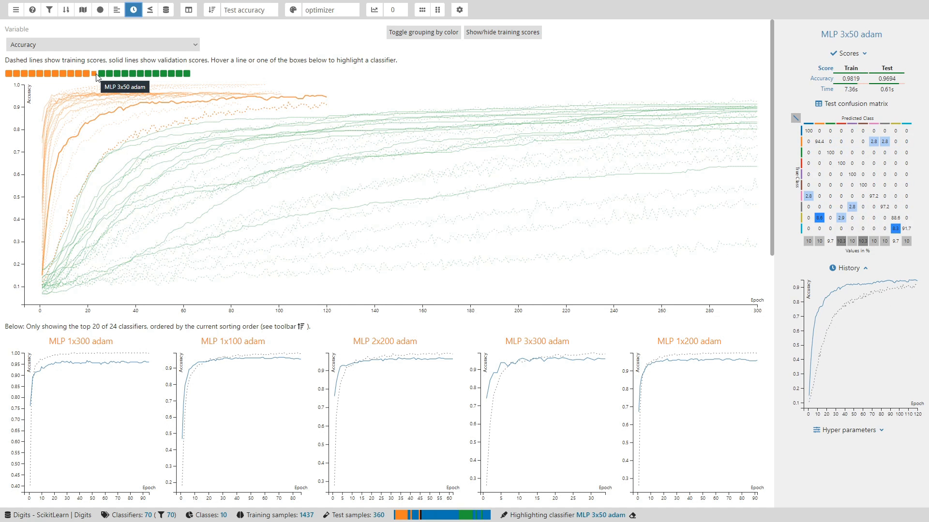
Notes:
Now, let’s see a video demo of this visualization:
In this example, we first highlight some classifiers via a legend,
we then try smoothing the lines,
and finally, we switch to the aggregated view.

Slide 56
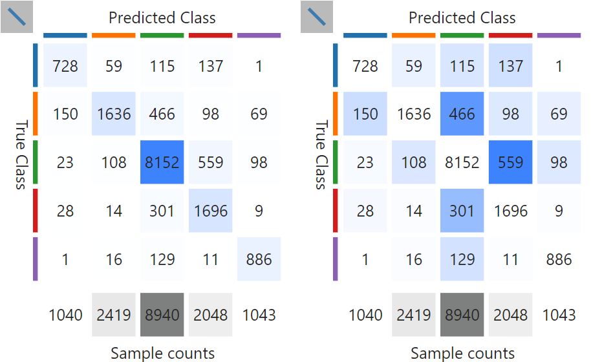
Analyzing Differences Between Classes
Classes can vary in difficulty
Confusion matrix shows how often pairs of classes were confused
Notes:
The last task I want demonstrate in this talk is the analysis of class confusion.
Classifiers can struggle with some classes more than with others.
For example, it is easier to confuse a cat with a dog,
than to confuse a cat with a ship or a plane.
Confusion matrices show how often a classifier confused all pairs of classes.
ClaVis provides color-coded confusion matrices for single classifiers as well as for multiple classifiers at once.

Slide 57
Analyzing Differences Between Classes
Diagonal shows numbers correctly labelled samples
Hiding it highlights the errors
Notes:
For good classifiers, the diagonal which shows the correctly classified samples, dominates the view.
This makes it hard to see the errors.
When we use the color map to only colorize errors, we can see them much more clearly.

Slide 58
How did we design and evaluate ClaVis?
Notes:
Now that I’ve shown you how ClaVis helps to understand the influence of hyperparameters, I want to explain how we designed and evaluated it.

Slide 59
Design Study Methodology*
Cooperation between two institutes
Three visualization experts
Three domain experts (natural language processing with ML)
Iterative design with regular meetings
* Sedlmair et al. (2012) Design study methodology: Reflections from the trenches and the stacks. IEEE TVCG 18, 12 , 2431–2440. doi.org/10.1109/TVCG.2012.213
Notes:
We based our design process on design study methodology.
During the design phase, three visualization experts cooperated with three machine learning experts
who are doing research at another institute of our university.
These machine learning experts have used classification for natural language processing before
and provided us with a lot of information and feedback in our regular meetings.

Slide 60
Evaluation
Qualitative evaluation
A demo & survey with ML students (formative)
Notes:
To see whether the workflow and visualizations are understandable,
we showed a demo of ClaVis to students and faculty members, who had not seen it before.
Based on their feedback, we improved ClaVis’ usability and added some requested features.

Slide 61
Evaluation
Qualitative evaluation
A demo & survey with ML students (formative)
Two case studies with domain experts & real world problems
Notes:
We conducted a final evaluation through two case studies.
For these studies, the main developer of ClaVis performed pair analytics sessions together with two of the machine learning experts.
This approach allowed the experts to use all features without the need for any prior training.
We let the experts choose datasets from their own domain of natural language processing.
They chose datasets that they have already worked with in the past,
since we wanted to know whether ClaVis helps them to find new insights.

Slide 62
Evaluation
Qualitative evaluation
A demo & survey with ML students
Two case studies with domain experts & real world problems
Both confirmatory and surprising insight (see paper for more)
Notes:
And indeed, besides confirming prior insights, we also made some new findings!
I presented some of them in this talk, these and more are described in our paper in further detail.

Slide 63
Conclusion
Notes:
This brings us to the conclusion of this talk.

Slide 64
ClaVis helps to make a more informed hyperparameter choice
ClaVis allows to compare classifiers to better understand the hyperparameter space
Sample HP Space,
Train Classifiers
Results
Visual Analysis,
Insight
Notes:
I demonstrated, how ClaVis supports developers in better understanding the influence of hyperparameters on classifiers.
To do this, ClaVis uses visual parameter space analysis, where we
first sample the parameter space and train classifiers
and then visually analyze the classifier’s scores, predictions, and training history.
This leads us to insight and allows for an informed parameter choice.

Slide 65
ClaVis helps to make a more informed hyperparameter choice
ClaVis allows to compare classifiers to better understand the hyperparameter space
Future work
Extend to other ML domains (e.g. regression, transformers)
Sample HP Space,
Train Classifiers
Results
Any prediction and score works!
Visual Analysis,
Insight
Notes:
In the future, we could extend our approach to other machine learning domains, such as regression or sequence-to-sequence transformers.
As long as there are parameters, predictions, and scores, ClaVis should be able to help!

Slide 66
ClaVis helps to make a more informed hyperparameter choice
ClaVis allows to compare classifiers to better understand the hyperparameter space
Future work
Extend to other ML domains (e.g. regression, transformers)
Integrate AutoML to find good HP values automatically
AutoML
Sample HP Space,
Train Classifiers
Results
Any prediction and score works!
Visual Analysis,
Insight
Notes:
Currently, users have to manually specify the parameter values they want to try.
We could integrate AutoML approaches to choose good defaults automatically.

Slide 67
ClaVis helps to make a more informed hyperparameter choice
ClaVis allows to compare classifiers to better understand the hyperparameter space
Future work
Extend the concept to other ML domains (e.g. regression, transformers)
Integrate AutoML (find good HP values automatically)
Take a look at our paper and github.com/fheyen/ClaVis for code & video demo!
Thanks for your attention!
Notes:
Please take a look at our paper for more details and at our supplementary material on GitHub for the full source code and a video demo!
Thank you for your attention!

